Slide 1
IDENTIFICATION OF RETINAL DISEASE USING BLOOD VESSEL EXTRACTION
AMRUTHA VV
MES20MCA-2007
PRODUCT OWNER:Mr.BALACHANDRAN KP

Slide 2
CONTENTS
INTRODUCTION
MODULES
DATA FLOW DIAGRAM
4. TABLE DESIGN
DEVELOPING ENVIORNMENT
USER STORY
PRODUCT BACKLOG
8. PROJECT PLANS
SPRINT BACKLOG PLANS
10. SPRINT ACTUAL

Slide 3
INTRODUCTION
Blood vessel in retina is an important component in finding the cardiovascular disease, ophthalmological disease and segmentation of vessel tree in retina is used for computerbased identification systems. It has been identified that in some cases the symptoms of some diseases such as Diabetic Retinopathy, Hemorrhages cannot be differentiated from that of the blood vessels while training the fundus images. The Image segmentation process is examined to increase the accuracy using debauched vessel segmentation method which will help us to remove the blood vessels from the fundus images and provides easy processing. The precise retinal vessel segmentation has been established and executed. The blood vessel extraction is an edge enhancement and detection algorithm are analyzed.The Edge Enhancement and Edge detection method(EEED method) separates the surplus edges and does not consider the blood vessels.The method is faster and finds the good results,the significance of the method to these method is to improve the blood vessels contrast and diffuse the anomalous topographies in the retina image.The process involved in the EEED method is, A retina image is convolved with gaussian large bluring kernel to extract the blood vessels. The blurred image contains only the illumination pattern and other patterns get lost. the Gaussian blurred image is obtained from the retinal fundus image, the other image can be formed in two stages.

Slide 4
The final image is the miniature of two images.The intensity in the lower range only is illuminated in a blood vessels of retinal fundus image. The blood vessels are having the lowest values with increased edges when compared to the background in a minimum. This blurred image is given as an input to the log filter of a certain kernel size.then it will remove the noise and move blood vessel on images more clearly. The significance of log filter gives the uniform background intensity image. The image consists of higher intensity and maintain uniform intensity and is to be processed for cannial edage detection.It returns a single intensity threshold that seperates pixels into two classes,forground and background.through this we will get a cleared structure of blood vessels.Then here we using algorithm is Convolution neural network(CNN).The blood vessel extracted images will be the trained using CNN.first we trained the system by giving image input from the datset.then we create a corresponding model.Here CNN use some layers input layer,ouput layer and hidden layer. From already labeled images in the data set, we gives images as a input to the system.and it will extract the pixels and generate a pattern,the pattern will be,same disease are one pattern,normal ones are one pattern like.so the CNN model have the knowledge to analyse the patterns.and The user uploads an image ,the cannial detection will preprocess it.and for detecting disease it will go two CNN and compare the images with the patterns and find the matching one and gives the corresponding output.

Slide 5
MODULES
1.Expert system
Login
Add&manage dataset
Add&manage tips
View feedback
Add&manage treatments
2.User
Registration
Login
Upload image&view result
View tips
Send feedback
View treatments

Slide 6
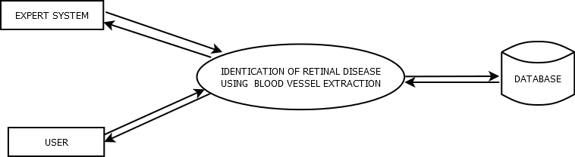
DATA FLOW DIAGRAM
Level 0:

Slide 7
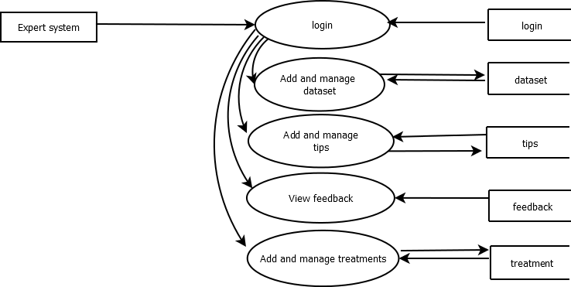
Level 1:

Slide 8
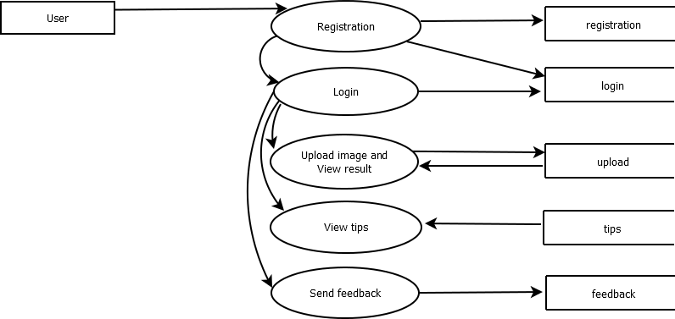
Level 2:

Slide 9
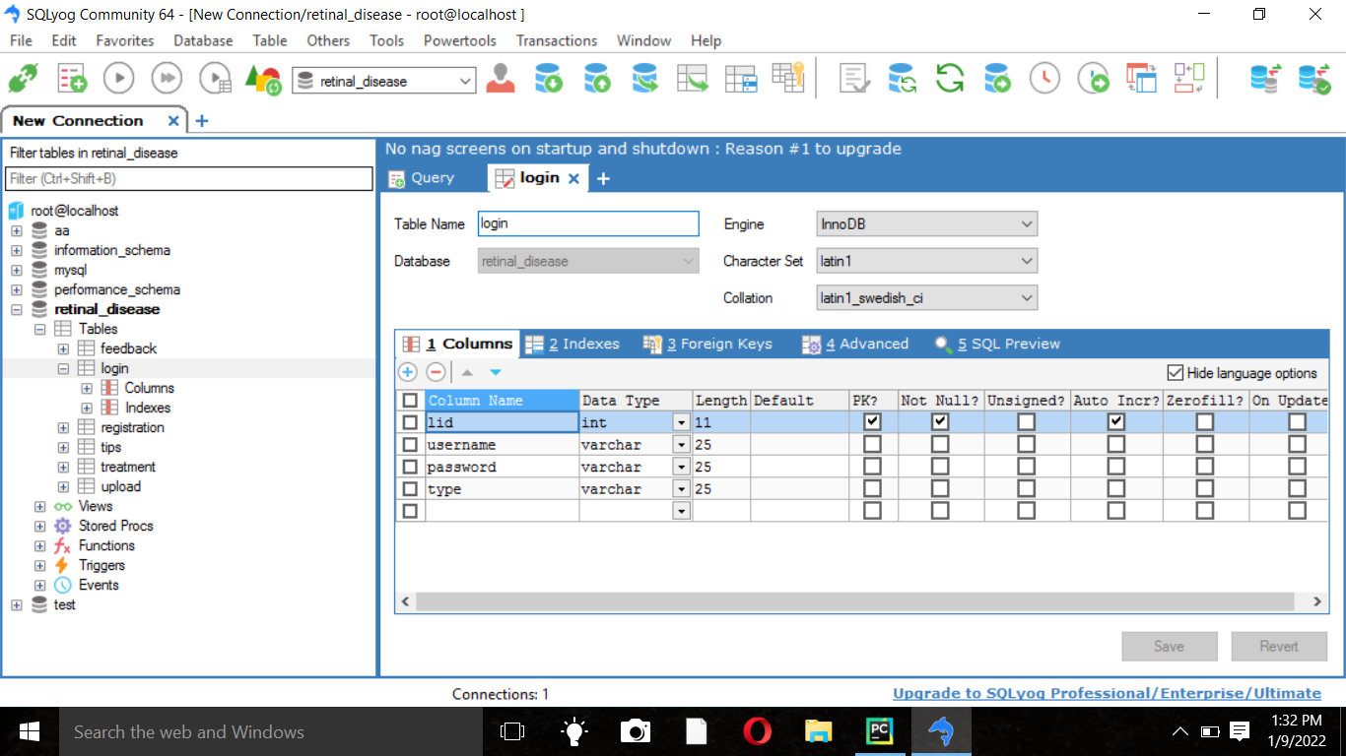
TABLE DESIGN

Slide 10
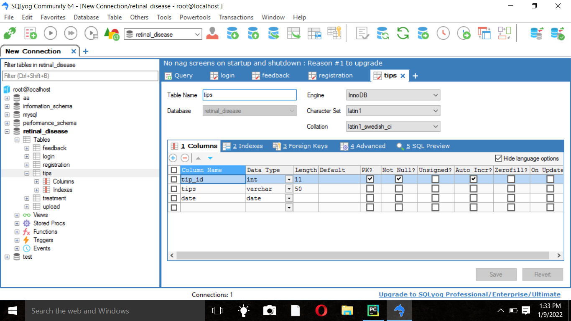

Slide 11
DEVELOPING ENVIORNMENT
OPERATING SYSTEM: WINDOWS 10
FRONT END: HTML, CSS, JAVASCRIPT
BACK END: Mysql
SOFTWARES USED: JetbrainsPycharm, Android Studio
TECHNOLOGY USED: PYTHON,JAVA
FRAME WORK USED: Flask

Slide 12
USER STORY
UserStoryID | As a <type of user> | I want to <perform some task> | So that I can <Achieve some goal>
1 | Expert | login | login successful with correct username and password
2 | Expert | Add and manage dataset | Add disease effected fundus image to dataset. Compare the uploaded image in here to predict the diease.
3 | Expert | Add and manage tips | Add tips for users and view the added tips.
4 | Expert | View feedback | View feedback
5 | Expert | Add and Manage treatments | Add treatments for users
6 | User | Register | User can register with this app
7 | User | Login | login successful with correct username and password

Slide 13
8 | User | Upload image and view result | Upload image and View result
9 | User | View tips | View added tips
10 | User | Send feeback | Send feedback
11 | User | View treatments | View added treatments

Slide 14
PRODUCT BACKLOG
User Story ID | Priority <High/Medium/Low> | Size (Hours) | Sprint <#> | Status <Planned/In progress/Completed> | Release Date | Release Goal
1 | Medium | 2 | 1 | Completed | 08/01/2022 | Table design
2 | High | 3 |  | Completed | 08/01/2022 | Form design
3 | High | 5 |  | Completed | 08/01/2022 | Basic coding
4 | High | 5 | 2 | Planned |  | Obtaining Gaussian blurred image from retinal image
 |  |  |  | Planned |  | Preprocessing
5 | Medium | 5
6 | High | 5 | 3 | Planned |  | Image classification
7 | Medium | 5 |  | Planned |  | Prediction
8 | Medium | 5 | 4 | Planned |  | Testing data
9 | High | 5 |  | Planned |  | Output generation

Slide 15
PROJECT PLAN
User Story ID | Task Name | Start Date | End Date | Days | Status
1 | Sprint 1 | 26/12/2021 | 28/12/2021 | 2 | Completed
2 |  | 29/12/2021 | 31/12/2021 | 3 | Completed
3 |  | 03/12/2021 | 08/01/2022 | 5 | Completed
4 | Sprint 2 | 09/01/2022 | 13/01/2022 | 5 | Planned
5 |  | 14/01/2022 | 18/01/2022 | 5 | Planned
6 | Sprint 3 | 19/01/2022 | 23/01/2022 | 5 | Planned
7 |  | 03/01/2022 | 07/02/2022 | 5 | Planned
8 | Sprint 4 | 08/02/2022 | 12/01/2022 | 5 | Planned
9 |  | 16/02/2022 | 20/02/2022 | 5 | Planned

Slide 16
SPRINT BACKLOG PLAN
Backlog Item ` | Status & completion date | Original estimate in hours | Day1 | Day2 | Day3 | Day4 | Day5 | Day6 | Day7 | Day8 | Day9 | Day10 | Day11 | Day12 | Day13 | Day14
User story #1,#2,#3, |  | hrs | hrs | hrs | hrs | hrs | hrs | hrs | hrs | hrs | hrs | hrs | hrs | hrs | hrs | hrs
Table design | 28/12/2021 | 2 | 1 | 1 | 0 | 0 | 0 | 0 | 0 | 0 | 0 | 0 | 0 | 0 | 0 | 0
Form design | 31/12/2021 | 3 | 0 | 0 | 0 | 1 | 1 | 1 | 0 | 0 | 0 | 0 | 0 | 0 | 0 | 0
Basic coding | 08/01/2022 | 5 | 0 | 0 | 0 | 0 | 0 | 0 | 0 | 0 | 0 | 1 | 1 | 1 | 1 | 1
User story #4,#5
Obtaining Gaussian blurred image from retinal image | 13/01/2022 | 5 | 1 | 1 | 1 | 0 | 0 | 1 | 1 | 0 | 0 | 0 | 0 | 0 | 0 | 0
Preprocessing | 18/01/2022 | 5 | 0 | 0 | 0 | 0 | 0 | 0 | 0 | 0 | 0 | 1 | 1 | 1 | 1 | 1
User story #6,#7

Slide 17
Image classification | 23/01/2022 | 5 | 5 | 1 | 1 | 1 | 1 | 0 | 0 | 0 | 0 | 0 | 0 | 0 | 0 | 0
prediction | 07/02/2022 | 5 | 0 | 0 | 0 | 0 | 0 | 2 | 1 | 2 | 0 | 0 | 0 | 0 | 0 | 0
User story #8,#9
Testing data | 12/02/2022 | 5 | 0 | 0 | 0 | 0 | 0 | 0 | 0 | 1 | 1 | 2 | 1 | 0 | 0 | 0
Output generation | 20/02/2022 | 5 | 0 | 0 | 0 | 0 | 0 | 0 | 0 | 0 | 0 | 0 | 0 | 2 | 2 | 1
Total |  | 40 | 3 | 3 | 2 | 2 | 2 | 4 | 2 | 3 | 1 | 4 | 3 | 4 | 4 | 3

Slide 18
SPRINT ACTUAL
Backlog Item | Status & completion date | Original estimate in hours | Day1 | Day2 | Day3 | Day4 | Day5 | Day6 | Day7 | Day8 | Day9 | Day10 | Day11 | Day12 | Day13 | Day14
User story #1,#2,#3 |  | hrs | hrs | hrs | hrs | hrs | hrs | hrs | hrs | hrs | hrs | hrs | hrs | hrs | hrs | hrs
Table design | 28/12/2021 | 2 | 0 | 0 | 0 | 1 | 1 | 0 | 0 | 0 | 0 | 0 | 0 | 0 | 0 | 0
Form design | 31/12/2021 | 4 | 0 | 0 | 0 | 0 | 0 | 0 | 1 | 1 | 1 | 1 | 0 | 0 | 0 | 0
Basic coding | 8/01/2022 | 4 | 0 | 0 | 0 | 2 | 0 | 0 | 0 | 1 | 1 | 1 | 0 | 0 | 0 | 0
User story #4,#5
Obtaining Gaussian blurred image from retinal image
Preprocessing
User story #6,#7
Image classification
prediction
User story #8,#9
Testing data
Output generation

Slide 19
THANK YOU

